Slide 1

HR Requirement

Slide 2
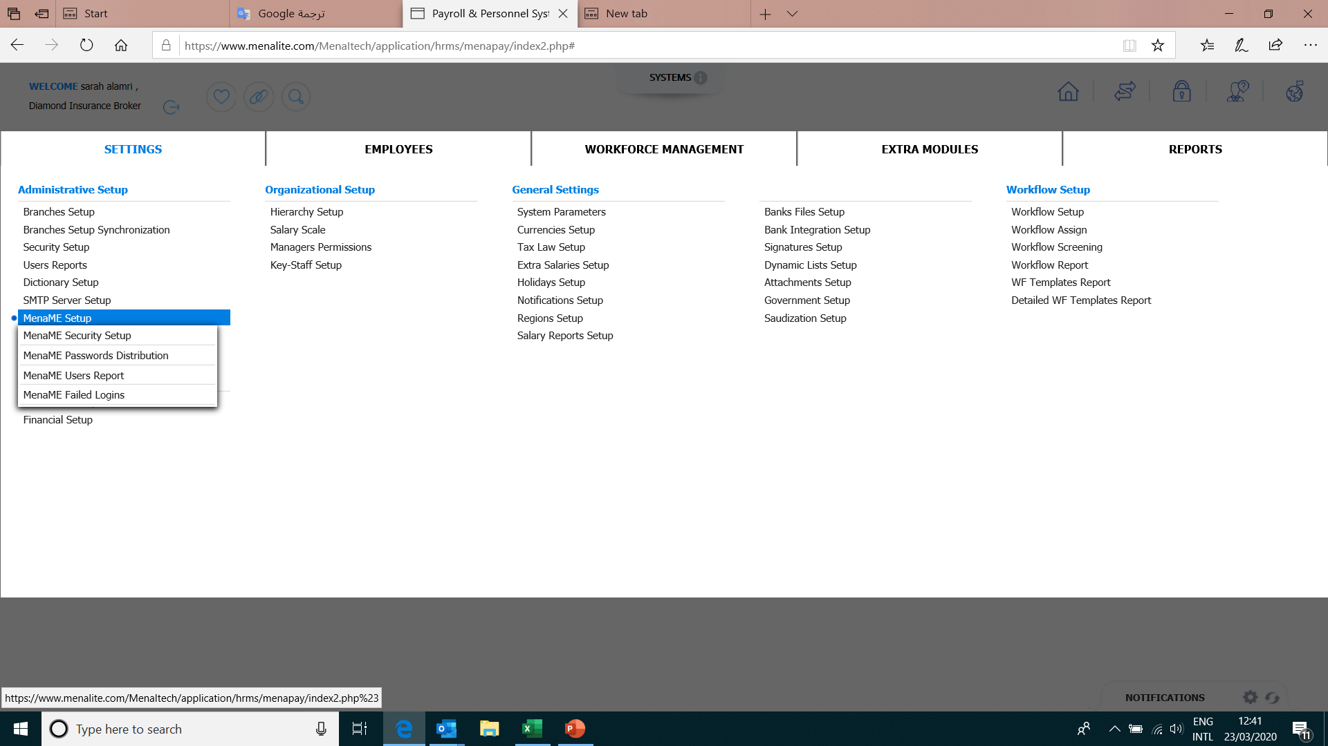
Settings
we use it when the employee forget the password

Slide 3
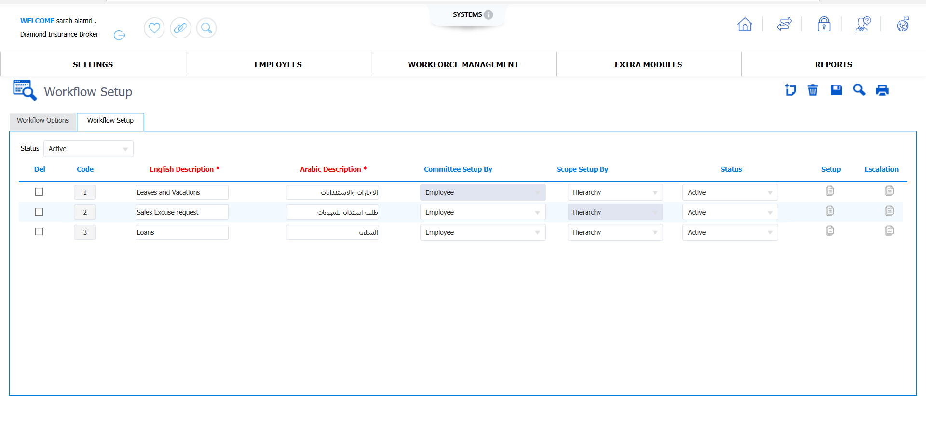
select who can approve : vacation - lone - leave...
Approvals : 1/direct manager
2/HR 3/finance manager 4/ general manager
Approvals : direct manager

Slide 4
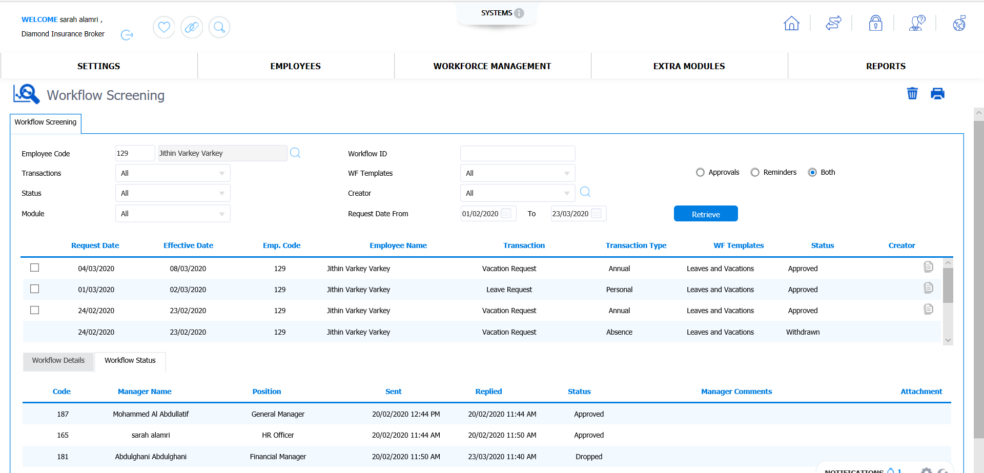
Workflow screening :
all requests
the request status

Slide 5
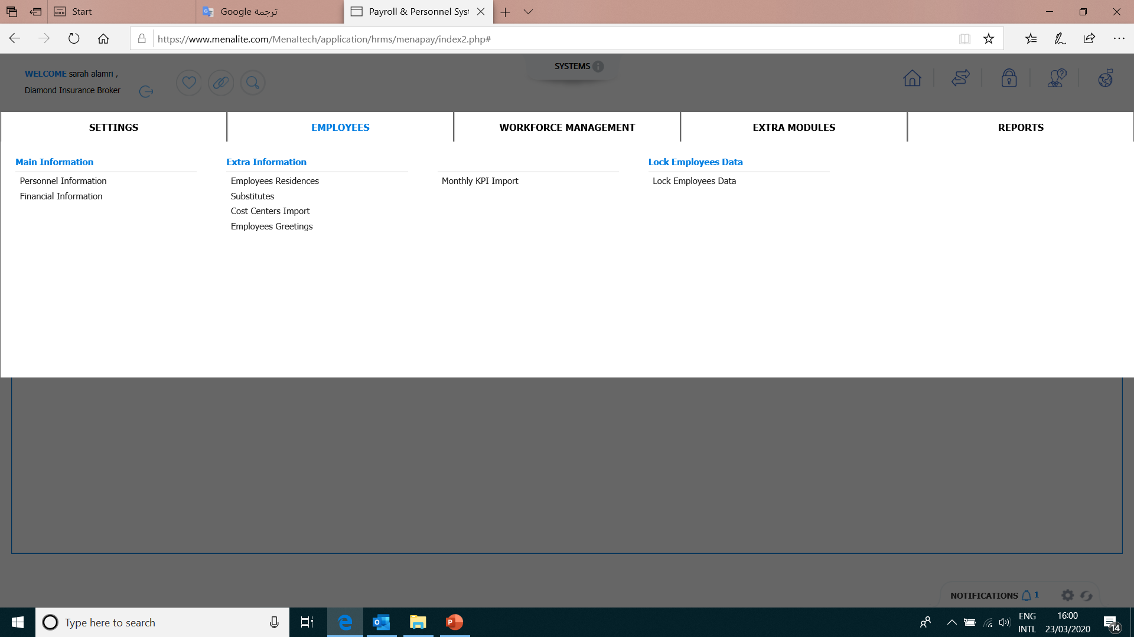
Total Salary 4500
Name
Employee Code
Basic salary
3300
Department
Birth Date
25%
Hiring Date
Housing
825
Transportation
375
Position
Direct Manager

Slide 6
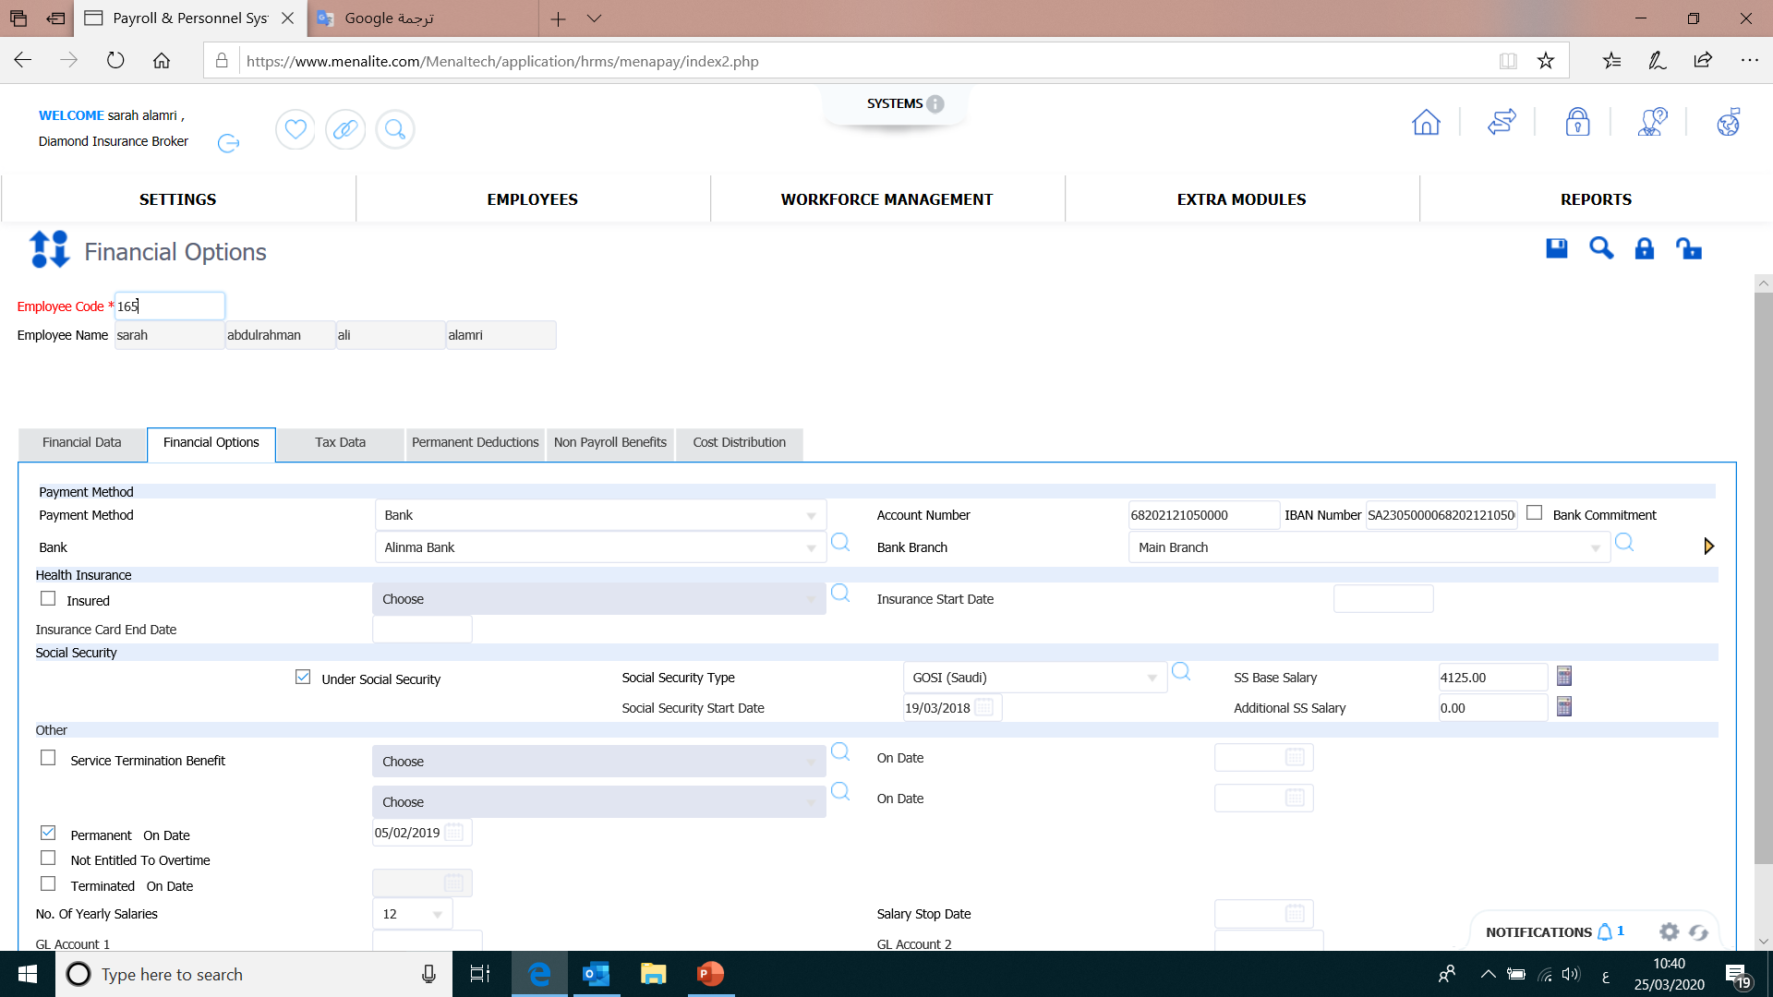
Saudi employee
Gosi
Gosi
Gosi
Gosi = Basic + Housing
*10% =412.5

Slide 7
Reports :
Vocation Balances
In-Advance Settlement Report
payroll report
employee termination report
loans statement

Slide 8
Thank you

